Slide 1
QSYS – Installation Overview
Daniel Berkowitz (ATS/ACR)

Slide 2
References
REF | Title | ALX | Notes
[1] | QSYS Buildings Overview.ppt | 46467661 | Master ppt by ACR Contains overview of QSYS related buildings Masterplan Layout, Buildings, Rooms
[2] | QSYS Commissioning Overview.ppt | 91190087 | Master ppt by ACR Contains „what“ has to be done
[3] | Sandbox Installation Plan.mmp | 92098277 | Sandbox planning in mpp by FDO
[4] | MINERVA Master Milestones.mmp | 32666094 | Master mmp by EDK
[5] | Project Structuring – Define the Framework.ppt |  | The how we ‘d like to embrace the making of the Installation & Commissioning planning for the 70 MeV Acc. The how the installation / commissioning should happen (focusing on project tools)
[6] | ATS_NFS_Planning.xlsx | 95494058 | Master Milestones by Diamantis

Slide 3
QSYS – System Breakdown
Cryoplant & Infrastructure
WCS
QRB
WSH
WSH
WSH
WPS
Cryo Backbone
QLM
QVB
QVB
QVE
Cryomodules
QM
QM
QCELL

Slide 4
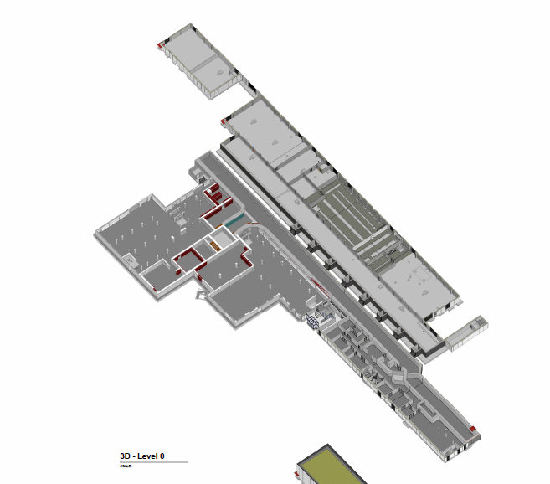
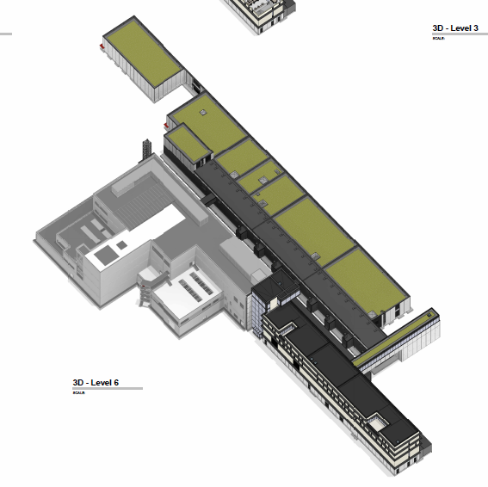
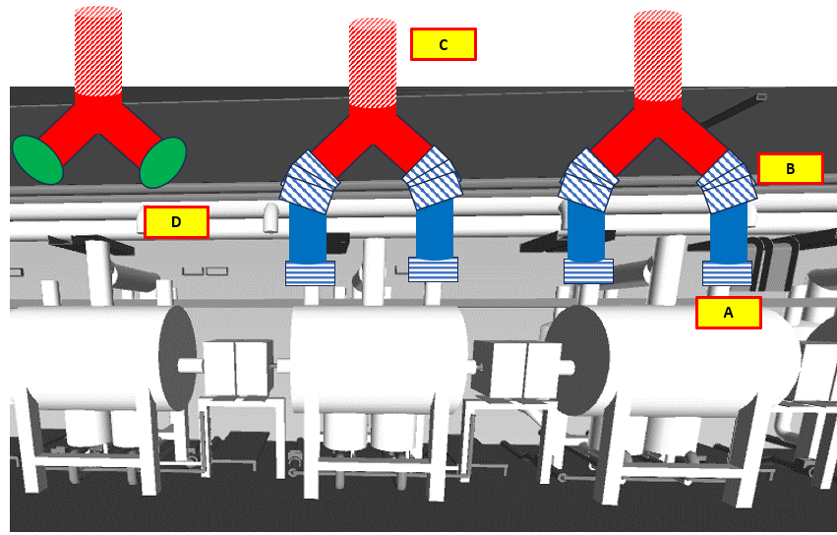
QSYS Buildings (QB_x)
[Slide from ALX/46467661]
Buildings - Level 0
QSYS is spread across SAB1, SAB2, and LTU
QSYS has high stakes when main equipment is installed, and low stakes when it is used for routing or peripherals
SCK CEN/83474410
High Stakes:
Main Equipment installed on premise
6
# | Building | QSYS top-level (*main) | QSYS Equipment
QB_1 | LTU/interior | QCELL* QDIST QINFRA | QM QVB QVE QLM WPS
QB_2 | LTU/Chicane | QDIST* QINFRA | QLM WPS
QB_3 | SAB2/RF-Gallery | QDIST* QINFRA | QLM WPS
QB_4 | SAB2/QRB Room | QPLANT QDIST QINFRA | QRB WPS QLM
QB_5 | SAB2/Other | QPLANT QINFRA? | WCS WPS?
QB_6 | SAB1/CCB | QPLANT QINFRA | WCS WSH
QB_7 | LTU/vents | QINFRA | WPS
QB_8 | SAB2/RF-Gallery | QCELL QDIST QINFRA | QC_int
Low Stakes:
Only peripherals or routing pipes
3
5
2
4
1
8
7

Slide 5
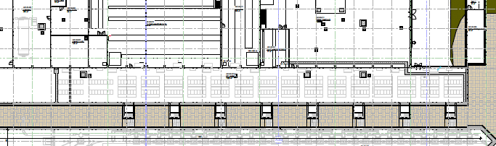
QDB Sectorization
Section 7
Section 6
Section 5
Section 4
Section 3
Section 2
Section 1
QDB Sectorization
Section names follow the convention: Section 1, Section 2, Section 3, etc.
The VLP-flow direction is the reference direction for all orientation and sectioning conventions.
When producing cross-sections or views, the observer is always “looking in the VLP-flow direction” (i.e., the VLP-flow goes into the screen).
Spools
Each spool is defined by two flanges: Flange A and Flange B
Flange A is the upstream flange (i.e., first in the VLP-flow direction), and Flange B is downstream
A QLM spool belongs to the section where its Flange A is located.

Slide 6
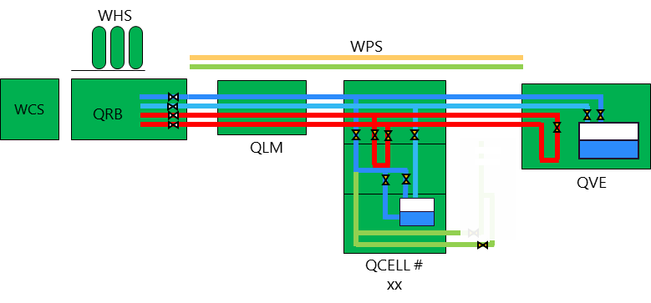
QSYS
Non-LTU
chicane
LTU

Slide 7
Definitions

Slide 8
Actions Terminology
HAND Handling – Move equipment in space
REL Relocating - Move equipment from external area into tunnel/building
POS Positioning - Place equipment in position (no alignment)
ALIG Alignment - Perform precise mechanical alignment to defined references
FUNC Functional Check - Verify system function
WARM At WARM – at room temperature
COLD At COLD – at cryo temeperature
ICON: Interface Connection – Connect interface
LAT To lateral system - Connect to neighboring occurrence of the same system (e.g. QVB to QVB)
VER To vertial system - Connect to another system (e.g. QM to QVB)
UTI To utility – Connect to

Slide 9
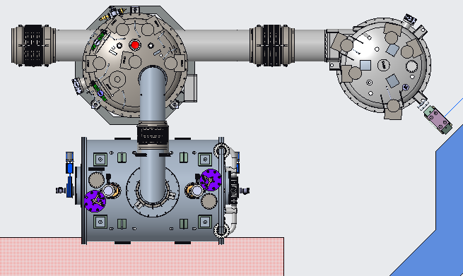
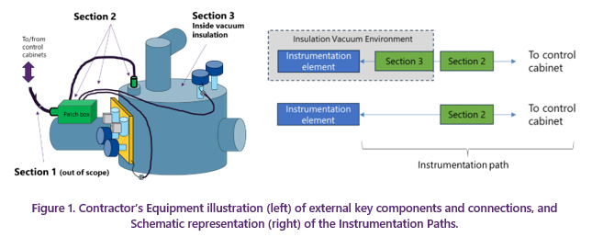
QCELL and QVE Equipment
QVB
QVB-:-QVB
QVB-:-QVE
QVB‘s Jumper
QVB-:-QM
QVE
QM‘s Chimney
QM
PeMo
(Peripherial Module)

Slide 10
QSYS Elements
Color coding
QVE - End Box
Generic
In position
QVB – Valve Box
INVAC closed
At cold
QM – Cryomodule
QLM – Cryoline spool
QPLANT‘s Cold Box
End cap (flind flange clossing an interface)

Slide 11
QSYS Equipment in LTU
Not shown yet:
WPS
Vent lines
Safety lines
Utilities
INVAC
AIR
:CS – control system
Interface connections
QLM-:-QLM
QLM-:-QVB
QVB-:-QVB
...
QVB-:-QM
QVE-:-QVB

Slide 12
REX from ESS

Slide 13
2023-12-50 - Strategy and installation experience for ESS SRF linac.pptx
REX from ESS
Pilot Installation of ESS-CM
4m installation, included
Alignment
Connect to larger cryo system
Welding to valve box
Warm He piping
Vent lines
Ancilliaries
Connect to RFDS
Water cooling
Compressed air
Cabling
Purpose
Collision resolution
Improve tools and precudre
Correct sequence of operations
Series Installation of ESS-CM
12 CMs in 5 months !

Slide 14
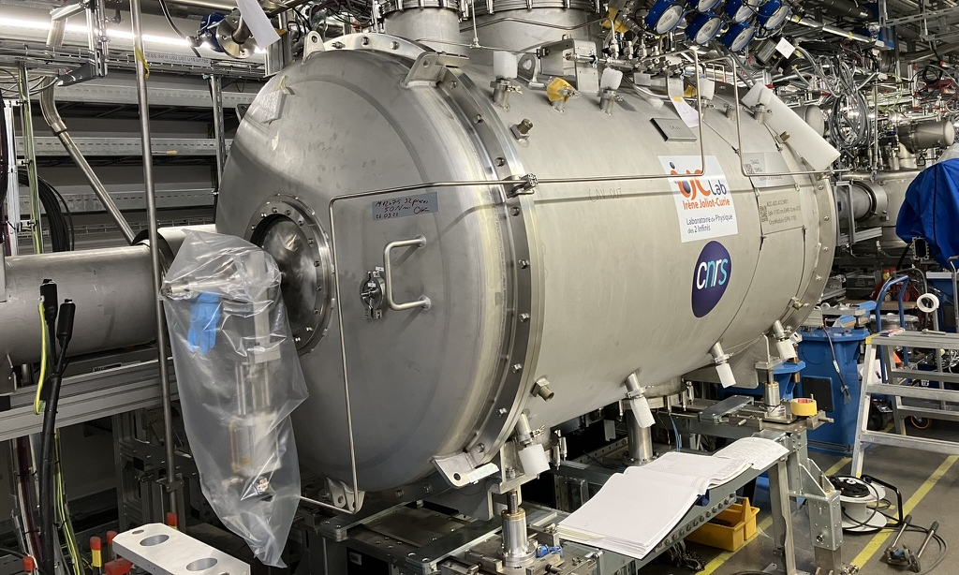
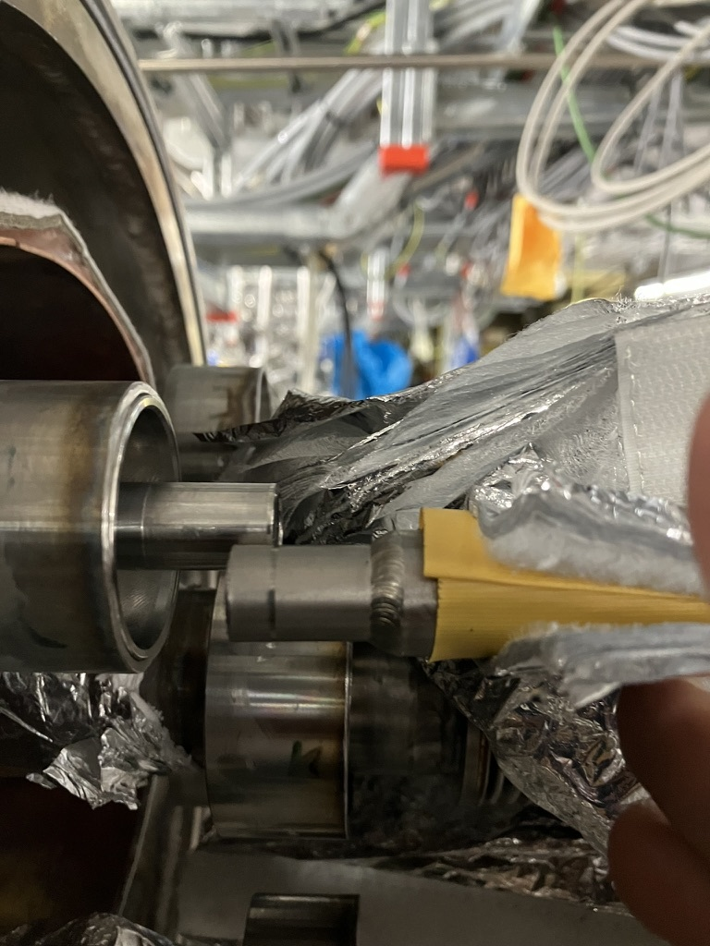
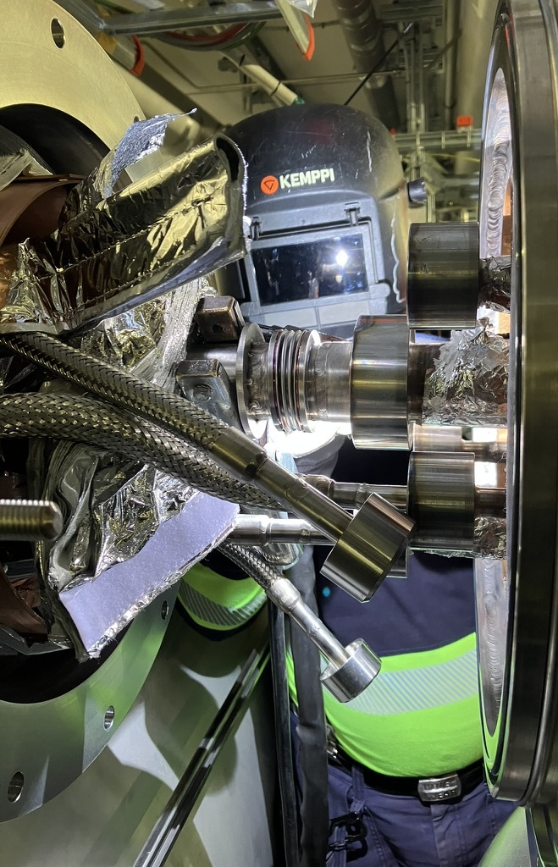
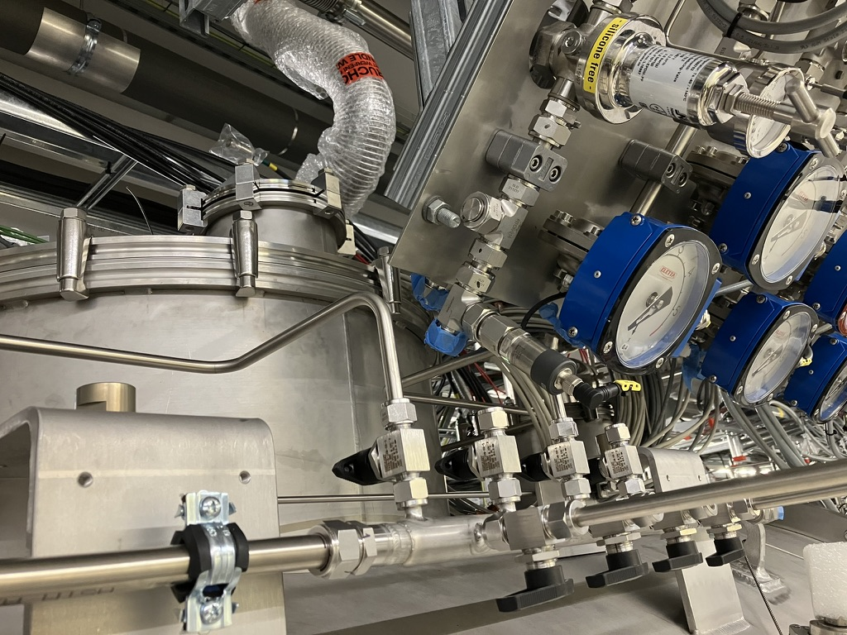
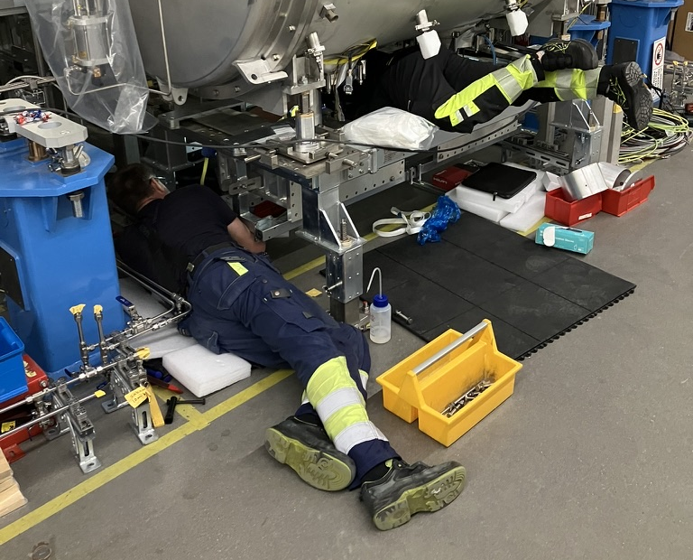
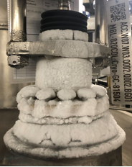
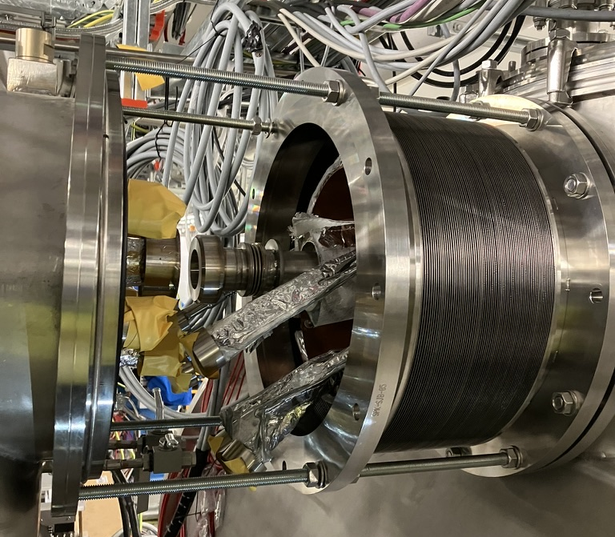
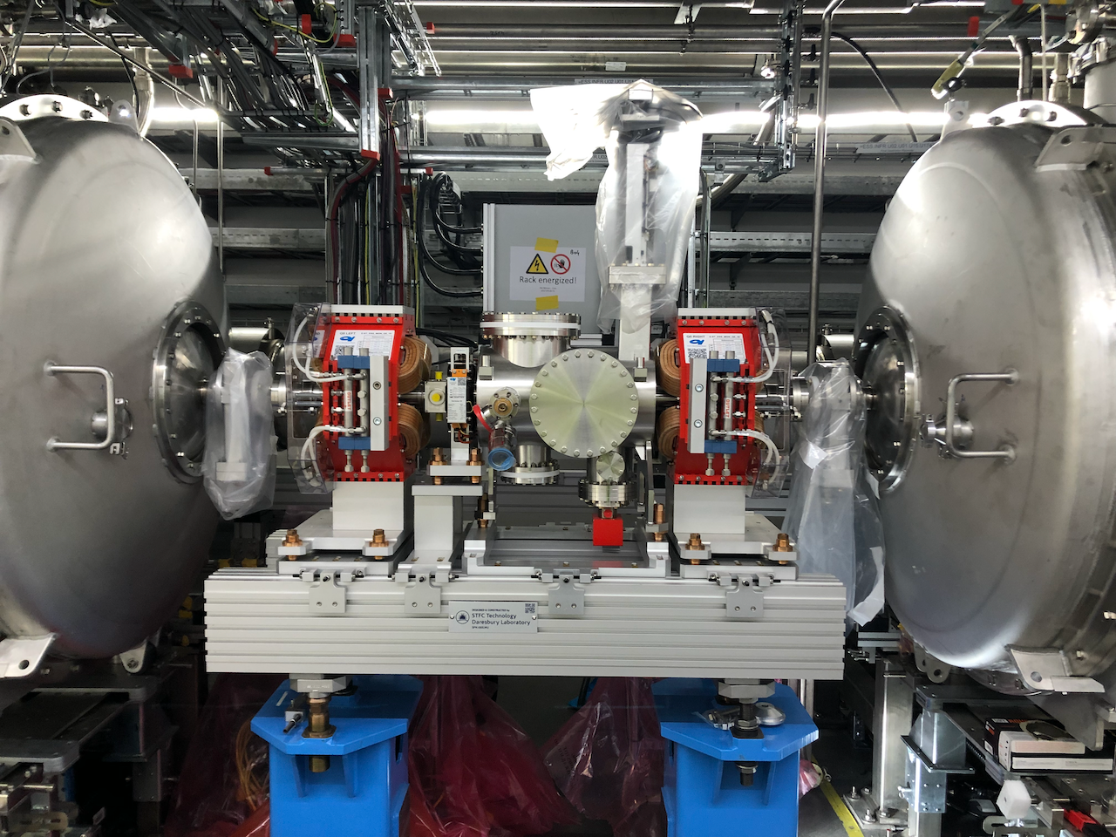
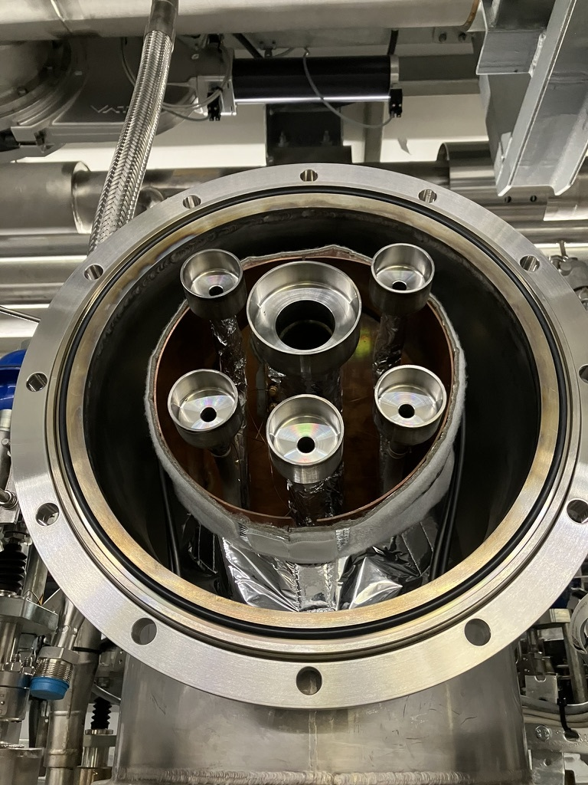
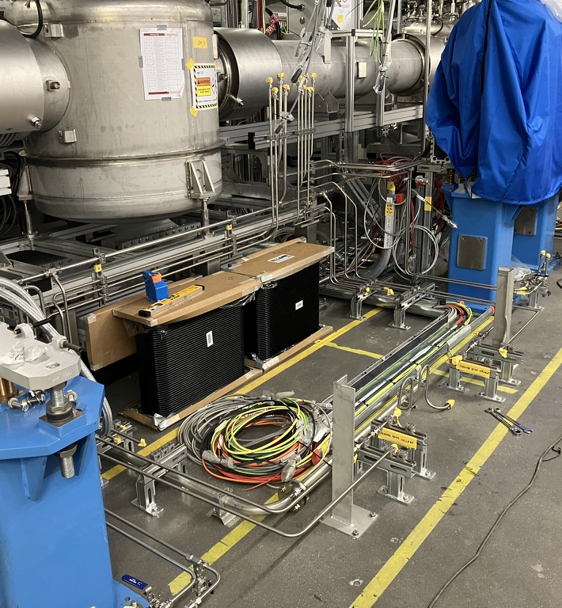
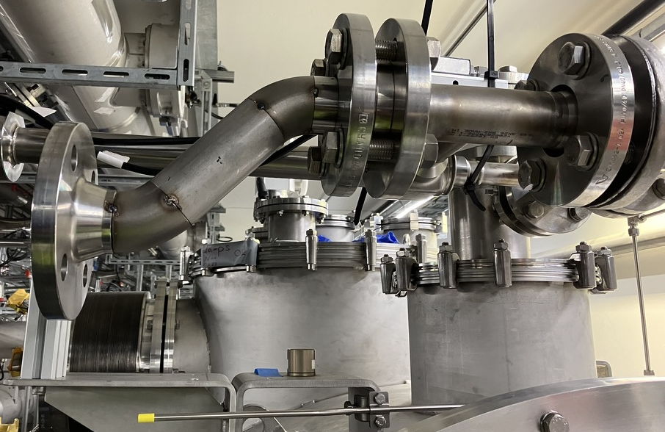
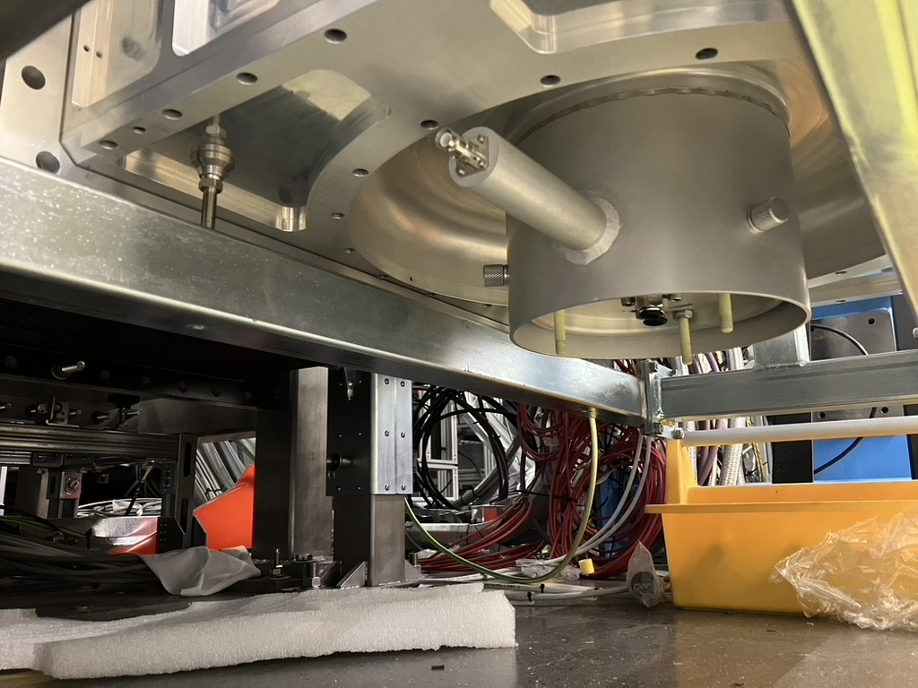
2023-12-50 - Strategy and installation experience for ESS SRF linac.pptx
REX from ESS (images)

Slide 15
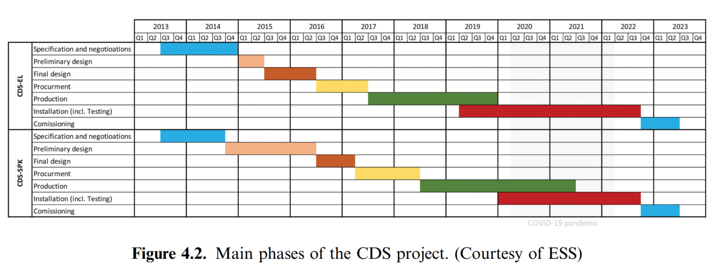
ESS book
To read absolutely
ESS Book - Chapter 3 Final.pdf https://ecm.sckcen.be/OTCS/llisapi.dll/link/91586851

Slide 16
QSYS Installation in the LTU

Slide 17
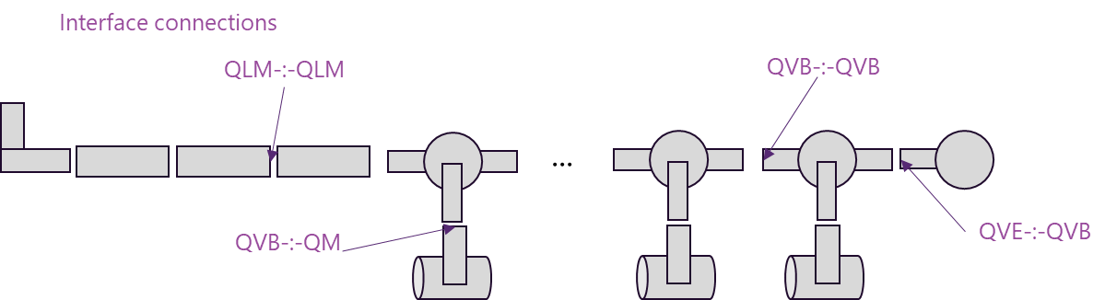
Constraints and Considerations
For Installation
General
Removal of any EndCap is only allowed when the respective system is at room temperature
Handling of QDB (=QLM, QVBs, QVE)
The QDBs are relocated and positioned by the QDB Contractor
The QDBs are aligned by the SCK CEN [TBC]
The QVB’s Jumper might be delivered as a separate item (due to space constraints during relocation)
Handling of QM
The QMs are relocated, positioned, and aligned by SCK CEN
Positioning can be in any order, provided the respective QVB is already in positioned
Note: Relocation still requires the QM vessel to pass through the already busy LTU corridor
Actions prior to positioning
For the QM, previous removal of the chimney’s end cap
For the QVB, previous removal of the jumper’s test cap (=end cap).
Connecting QDB’s Internal Interfaces (QVB-:-QVB & QLM-:-QLM & QVB-:-QLM & QVB-:-QVE)
Scope of the QDB Contractor (part of SAT1)
These connections are all identical by design (=standardize effort)
Duration:
1 week per connection [TBC]
Connecting QDB’s External Interfaces
QM-:-QVB
Scope of QDB Contractor (part of acceptance during “SAT2”)
Connecting a QM to a QVB is only allowed with a warm QDB
Timing: Preferred is after concluding QDB’s cold qualification. [see commissioning constraints]
Duration:
1 week per connection [TBC]
Cabling and Cabinets
All cryo equipment will be equipped with a “patch panel” to centralize all electrical wires. This patch panel then connects to the multi-signal cables running towards the “cryo cabinets” in the AUB. [FYI, cryo calls all cabling between the patch panel and the cabinets “Section 1” of the Instrumentation Path]

Slide 18
Constraints and Considerations
For Commissioning
Cool-down
The QDB can only be cooled down as a whole (no missing elements such as QLM, QVBs, or QVE)
The QDB can be cooled down with any number of installed QMs (zero, a few, or all)
Cooling down the QDB requires:
A working QPLANT, QDB:CS (control system of QDB), WPS (cryo warm pipping system)
The QVB-:-QM interface to the closed by either
the respective QM, or
an end cap (= special blind flange). For the QVB, this end cap doubles as “test cap”
Cold testing
The QDB Cold Test “can” be performed with any number of QMs
The QDB Cold Test “should” be performed with zero QMs.
This is to reduce technical & contractual risks, and is negotiable in case of conflict with (project) schedule/goals.
QDB Contract: the SAT2 requires all QMs to be connected

Slide 19
QSYS Readiness Requirements
For QDB Commissioning Run 1
Required to be ready
Controls and Interlocks
CIS scope for cryo
Cryo cabinets (includes power supplies, signal conditioners, PLC cards) (scope ICS)
Any interlock system (LPS or DIS)
Electrical
Connect patch panel to “Section 1” cable (includes grounding, power cables, signal cables) (scope NFS)
INVAC Systems
Connect pumps and gauges to QDB and QM (scope ACM-team)
Instrument Air
Connect dedicated air header to QDB (scope NFS)
Water system
CPLR water loop running (scope NFS)
LTU Infrastructure (scope NFS)
Oxygen deficiency monitors
Safety devices
Presence controls (tbc if we limit LTU presence)
QSYS (Minerva Cryogenic System)
QPLANT, Cryoplant – 100 %
QDIST, Cryo Distribution – 100 %
Full QDB
Includes PeMo-FLOW1, to be installed in AUB
QINFRA, Cryo Infrastructure – up to 80 %
WPS (Warm piping system)
QM, Cryomodules – 1 of 24
NOT Required to be ready
Any RF related equipment or cabinet
[unless the project & RF-Team decides to perform RF activities right after we are done; like CPLR conditioning; that would be too ambitious in my opinion]
SSA
TXL
BVAC
Warm beam-line sections

Slide 20
QSYS Installation & Commissioning (in LTU)
QDB Stand-Alone Installation
Activities
Install QDB’s support structures
Place QDB Elements (QLM, QVBs, QVE).
Align and interconnect all QDB Elements.
Connect all QDB Internal Interfaces (QVB-:-QVB, QLM-:-QLM, QVB-:-QLM, QVB-:-QVE).
Install all applicable PeMos.
Constraints / Requirements
Installation order and slot allocation shall follow SCK CEN instructions.
Space limitations from QRB test cap shall be considered in planning/sequencing.
No material transport or tools are provided by SCK CEN.
QDB Interface Installation (Phase A)
Activities
Connect QLM-:-QRB
First remove QRB test cap
Make connection *
Cabling
QDB to Section 1
Section 1 to Cabinets
Connect all QDB Elements to Site Utilities
Connect all QDB to INVAC
Connect all QDB Elements to WPS
Install pilot QM
Connect pilot QVB-:-QM
First position QM
Make connection *
(*) Make Connection means,
Join process pipes.
Restore continuity of thermal shields and MLI.
Join vacuum jackets.
Constraints / Requirements
QPLANT is fully operational
QDB Cabinets are installed
Removal of any end cap only at room temperature.
QRB remains capped until QLM connection is scheduled (≥2 months advance notice to SCK CEN).
Each QVB must be installed before its respective QM.
QM relocation/alignment by SCK CEN; sequencing shall adapt accordingly.
TC-LB removal from QVB performed upon SCK CEN request before QM placement.
External QM-:-QVB connections only when QDB is warm.
SCK CEN does not provide any material transport nor tools to QDB Contractor.

Slide 21
QSYS Installation & Commissioning (in LTU)
QDB Commissioning Run 1
Activities
Constraints / Requirements
QDB Interface Installation (Phase B)
Activities
Install all QMs
Connect all QVB-:-QM
First position QM
Make connection *
Connect all QMs to Site Utilities
Connect all QMs to INVAC
Connect all QMs to WPS
(*) Make Connection means,
Join process pipes.
Restore continuity of thermal shields and MLI.
Join vacuum jackets.
Constraints / Requirements

Slide 22
QDB Contractors Scope
Source: QDB Tender Specs: ALX/44845497 - 22 AUG 2025
For QDB Stand-Alone Installation
Obligations:
Install support structures and place all Backbone Elements (QLM, QVBs, QVE).
Align and interconnect all Backbone Elements.
Connect all internal interfaces (QVB–QVB, QLM–QLM, QVB–QLM, QVB–QVE).
Install all applicable PeMos.
Constraints/Requirements:
Follow SCK CEN instructions for installation order and slot allocation.
Account for space limitations caused by the QRB test cap when planning and sequencing.
No material transport or tools provided by SCK CEN.
For QDB Interface Installation
Obligations:
Connect the QLM spool to the QRB after removal of the QRB test cap.
Connect all Backbone Elements to site infrastructure.
Connect each QVB to its respective QM after QM positioning.
Complete process connections, including:
Joining process pipes.
Restoring continuity of thermal shields and MLI.
Joining vacuum jackets.
Supply all connection materials (fittings, gaskets, seals, consumables, shield/MLI segments).
Perform QA/QC for all connections.
Constraints/Requirements:
Removal of any end cap only at room temperature.
QRB remains in operation with test cap until QLM connection is scheduled (≥2 months advance notice to SCK CEN).
Each QVB must be installed before its respective QM.
QM relocation and alignment is performed by SCK CEN; Contractor to adapt sequencing accordingly.
TC-LB removal from QVB required upon SCK CEN request before QM placement.
External QM–QVB connections only when QDB is warm.
No material transport or tools provided by SCK CEN.

Slide 23
QDB Contractors Scope
Source: QDB Tender Specs: ALX/44845497 - 22 AUG 2025
For QDB Commissioning (General)
Obligations:
Lead all commissioning activities (SCK CEN/FREIA operate the Instances).
Define and provide detailed procedures per activity.
List all activities required to ensure readiness of installed Instances.
Define operational limitations to be respected.
Record all results in Commissioning Reports.
Ensure resources are present to witness SCK CEN tests.
Activities:
Functional
Valve actuation and monitoring.
Instrumentation monitoring and calibration verification.
Cleaning and conditioning of helium circuits.
Integration
Control and interlock system.
Cryogenic system (QRB, WPS, QM).
Ancillary systems (e.g. INVAC).
Utilities (instrument air).
Performance:
INVAC levels.
Heat load measurements.
Cool-down dynamics (speed, gradients).
Warm-up dynamics (speed, gradients).
Stability of all helium circuits (levels, pressures).
Leak rate of valve seats at cold.
Valve permeability.
Absence of thermo-acoustic oscillations.
Absence of cold spots.
For QDB Commissioning Runs
RUN 1:
Shall start only after QDB installation and connection to QRB + site infrastructure.
The Contractor shall verify function and performance of the TC-LB.
RUN 2:
Shall start only after all QMs are connected to QVBs.
The Contractor shall
Verify QM integration.
Verify QM displacement.

Slide 24
Copyright © SCK CEN
All property rights and copyright are reserved.
This presentation contains data, information and formats for dedicated use only and may not be communicated, copied, reproduced, distributed or cited without the explicit written permission of SCK CEN.
If this explicit written permission has been obtained, please reference the author, followed by ‘by courtesy of SCK CEN’.
Any infringement to this rule is illegal and entitles to claim damages from the infringer, without prejudice to any other right in case of granting a patent or registration in the field of intellectual property.
SCK CEN
Belgian Nuclear Research Centre
Studiecentrum voor Kernenergie
Centre d'Etude de l'Energie Nucléaire
Foundation of Public Utility
Stichting van Openbaar Nut
Fondation d'Utilité Publique
Registered Office:
Avenue Herrmann-Debrouxlaan 40 - 1160 BRUSSELS - Belgium
Research Centres:
Boeretang 200 - 2400 MOL - Belgium
Chemin du Cyclotron 6 - 1348 Ottignies-Louvain-la-Neuve - Belgium

Slide 25
QDB – Q&C Gantt Chart
Installation Phase A (pre-SAT1)
Only Backbone Elements
Only elements that are scope of QDB Tender.
QLM spools
All QVBs
Test caps (!)
QVE
PeMo whenever applicable
No external interfaces. Thus, independent from other QSYS equipment.
Excludes: Chimmney welds, QRB welds
Installation Phase B
QRB-welds
Interfaces to site infrastructure
Plugging cables to patchbox
Installation Phase C
24x QM-Chimey welds
Remaining PeMos
SAT1
Installation
Phases A-B-C
.....
SAT2
Commissioning
QDB Cold Testing Scenario A
QDB Cold Testing Scenario B
QDB Cold Testing
Operated by SCK
Contractor withnesses
Cold-issues:
If on SAT1-component: Contractor fixes as part of warranty
If on SAT2-component: Contractor fixes as preparation towards SAT2

